Slide 1
Error correction
Hamming Code

Slide 2
Hamming code
Hamming code is a set of error-correction codes that can be used to detect and correct the errors that can occur when the data is moved from from sender to receiver
The redundant bits play an important role in detecting and correcting errors.
In Hamming code the redundant bits used for error detection and correction is parity bit
Redundant bits are the extra binary bits that are added to the original data bits, which are ready to transfer from sender to receiver for ensuring that no bits were lost during the data transfer.
Parity bits are the extra bits that are added to the original data(binary bits) so that the total number of 1s is even in case of even parity or odd in case of odd parity.

Slide 3
Hamming code
The number of redundant bits can be calculated using the following formula:
2^{r} ≥ m + r + 1
where, r = redundant bit, m = data bit
Suppose the number of data bits is 7, then the number of redundant bits can be calculated using: = 2^4 ≥ 7 + 4 + 1 Thus, the number of redundant bits= 4 Parity bits.

Slide 4
Question
What should be the number of redundant bits if the data bits is 4?
if data bits are 4 then the number of redundant bits can be calculated as 2^3 >= 4+3+123>=4+3+1 where 3 is the required number of redundant data bits so that no data is lost during the transmission

Slide 5
Determining position of parity bits:
Parity bits are placed at the bit position which is the power of 2 i.e, (2^0 , 2^1, 2^2, 2^3, 2^420,21,22,23,24,.... so on) which are (1,2,4,8,... so on ).
So for example, in the 7-bit data transfer we will be having 4 parity bits which are (1,2,4,8).
Similarly in the 4-bit data transfer we will be having 3 parity bits which are (1,2,4).

Slide 6
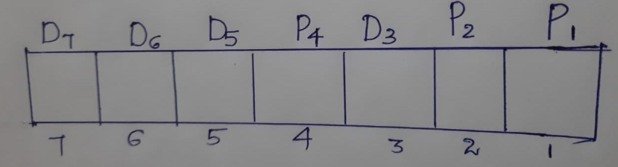
Determining position of parity bits and data bit :
The first step is to identify the bit position of the data and parity bits.
All the bit positions which are powers of 2 are marked as parity bits (e.g. 1, 2, 4, 8, etc.).
Remaining bit positions are for data its
The following image will help in visualizing the received hamming code of 7 bits.

Slide 7
Determine the parity
Parity P1 depends on the data bit D3,D5,D7,D9….(Check one ,skip one)
Parity P2 depends on the data bit D3,D6,D7,D10,D11.. (Check two ,skip two)
Parity P4 depends on the data bit D5,D6,D7,D12,D13,D14,D15(Check four ,skip four)

Slide 8
Question
Suppose the data to be transmitted is 1011 using Hamming code using even parity.
Since the data bits is 4 bits ,the number of redundant bits is 3.

Slide 9
General Algorithm of Hamming code:
Hamming Code is simply the use of extra parity bits to allow the identification of an error.
Write the bit positions starting from 1 in binary form (1, 10, 11, 100, etc).
All the bit positions that are a power of 2 are marked as parity bits (1, 2, 4, 8, etc).
All the other bit positions are marked as data bits.

Slide 10
General Algorithm of Hamming code:
Each data bit is included in a unique set of parity bits, as determined its bit position in binary form.
a. Parity bit 1 covers all the bits positions whose binary representation includes a 1 in the least significant position (1, 3, 5, 7, 9, 11, etc).
b. Parity bit 2 covers all the bits positions whose binary representation includes a 1 in the second position from the least significant bit (2, 3, 6, 7, 10, 11, etc).
c. Parity bit 4 covers all the bits positions whose binary representation includes a 1 in the third position from the least significant bit (4–7, 12–15, 20–23, etc).
d. Parity bit 8 covers all the bits positions whose binary representation includes a 1 in the fourth position from the least significant bit bits (8–15, 24–31, 40–47, etc).
e. In general, each parity bit covers all bits where the bitwise AND of the parity position and the bit position is non-zero.
Since we check for even parity set a parity bit to 1 if the total number of ones in the positions it checks is odd.
Set a parity bit to 0 if the total number of ones in the positions it checks is even.

Slide 11
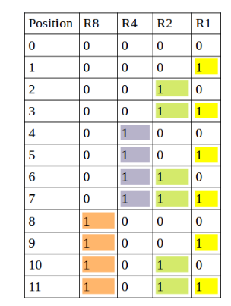

Slide 12
Question
If the 7 bit hamming code received by the receiver 1011011.state whether the received code word is correct or wrong .If wrong locate the bit having error.(Assume even parity is used)

Slide 13
Question
Suppose the data to be transmitted is 1011001 using hamming code.
How the data is transmitted.

Slide 14
Question
The data received by the receiver is 10101101110.state whether the received code word is correct or wrong .If wrong locate the bit having error.(Assume even parity is used)

Slide 15
Question
The data received by the receiver is 10101101110.state whether the received code word is correct or wrong .If wrong locate the bit having error.(Assume even parity is used)
Solution at
https://www.geeksforgeeks.org/hamming-code-in-computer-network/

